Slide 1
Ch.7 Loops​

Slide 2
What you will learn in this chapter
Understanding the concept of repetition
while loop
do-while loop
for loop
break and continue statements
The repetition structure allows you to repeat a series of processes. First, understand the concept of repetition and learn about the three repetition structures provided in C.

Slide 3
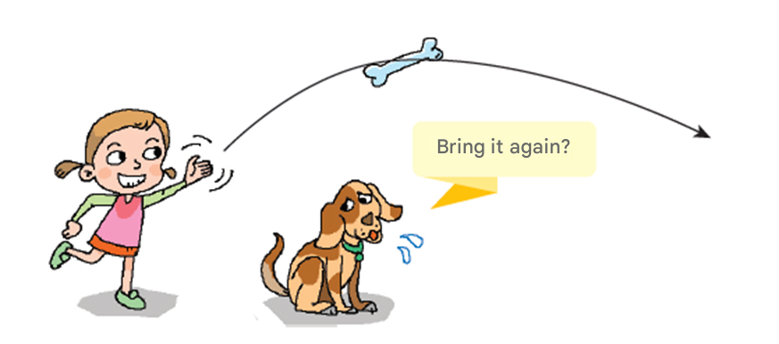
repeat
Repetitive tasks are essential in programs.
Iteration is repeating the same process multiple times.

Slide 4
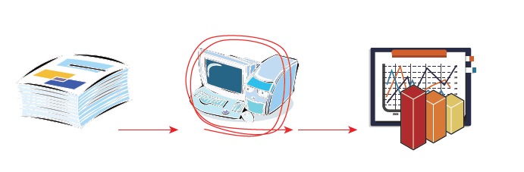
Why is repetition necessary ?
Q) Why is a repeating structure necessary ?
A) Many tasks on a computer can be processed efficiently and quickly by handling repetitive tasks.

Slide 5
Why is repetition important ?
printf ( "Hello World! \n" );
printf ( "Hello World! \n" );
printf ( "Hello World! \n" );
printf ( "Hello World! \n" );
printf ( "Hello World! \n" );
for (i = 0; i < 5; i++)
printf ( "Hello World! \n" );

Slide 6
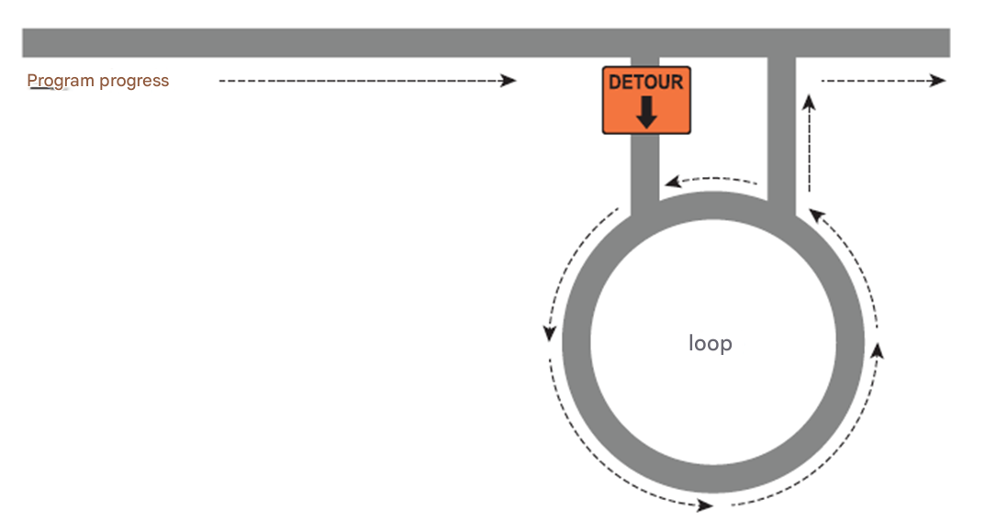
repeat structure
A structure that loops until a certain condition is satisfied.

Slide 7
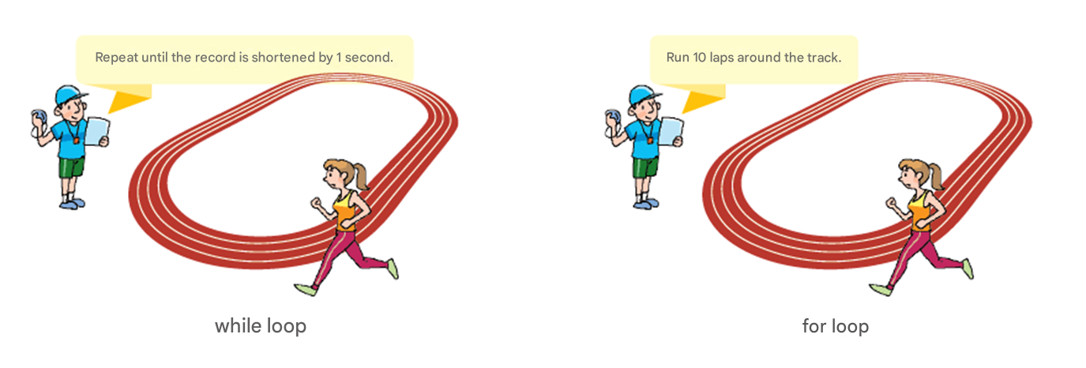
Types of loops
Repeat until the record is shortened by 1 second
Run 10 laps around the track

Slide 8
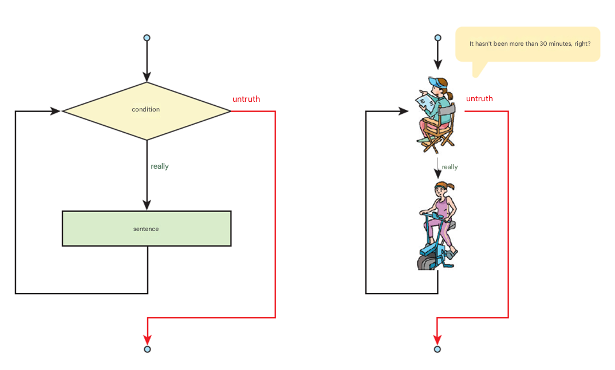
while statement
Repeats execution of statements while a given condition is satisfied.
Hasn't it been more than
30 minutes?
False
False
Condition
True
True
Sentence

Slide 9
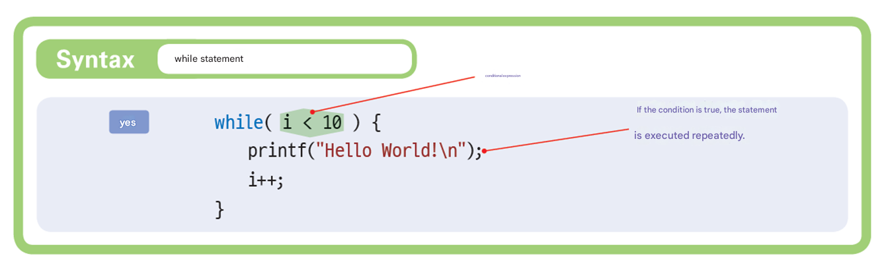
“while” statement
Conditional statement
If the condition is true, the statement is
executed repeatedly.

Slide 10
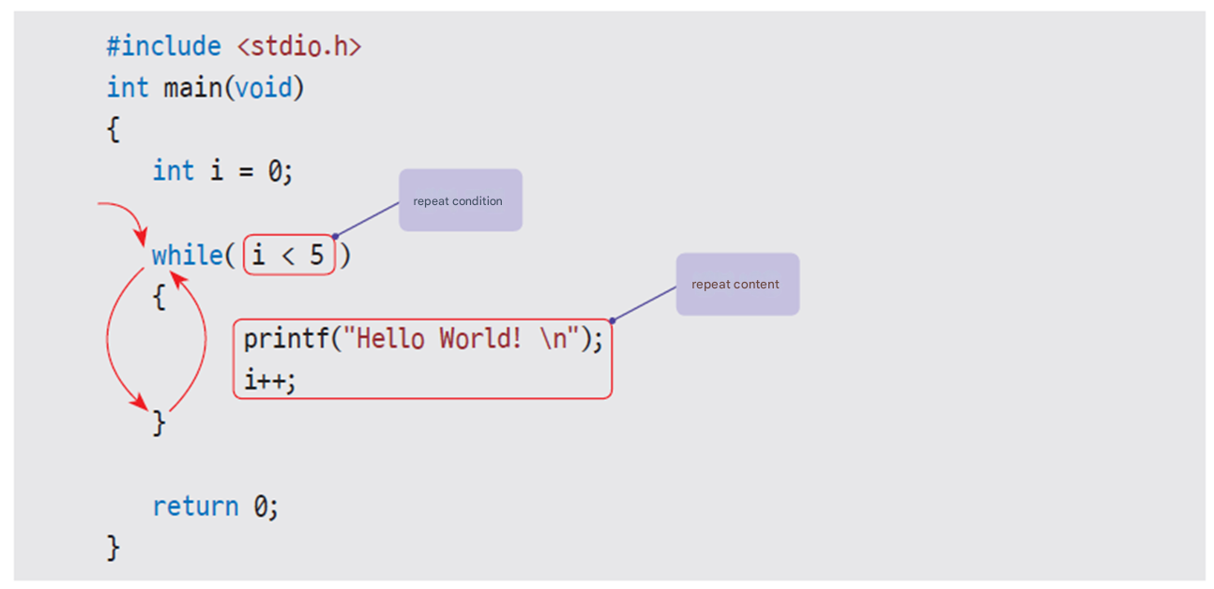

Example
Repeat condition
Repeat content
Hello World!
Hello World!
Hello World!
Hello World!
Hello World!

Slide 11
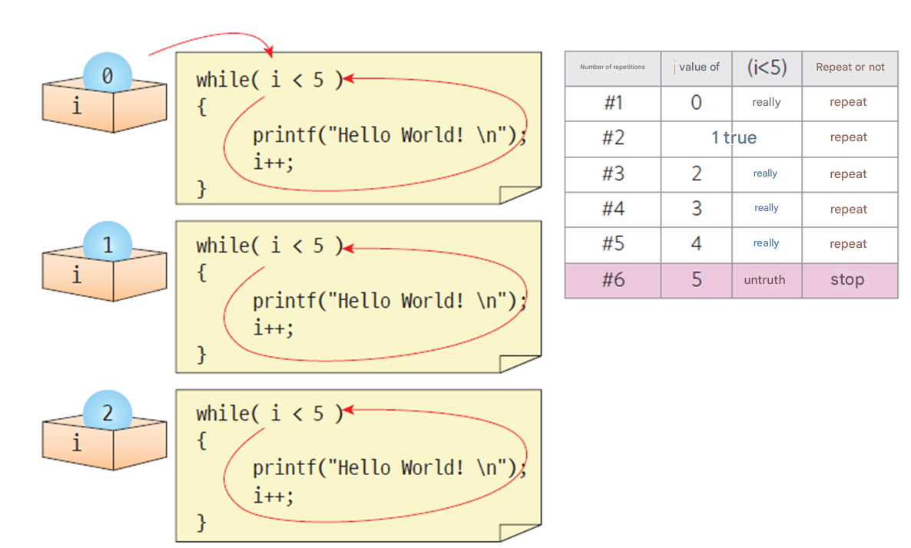
while statement execution process
Number of repeat
Value of i
True
True
True
True
True
False

Slide 12
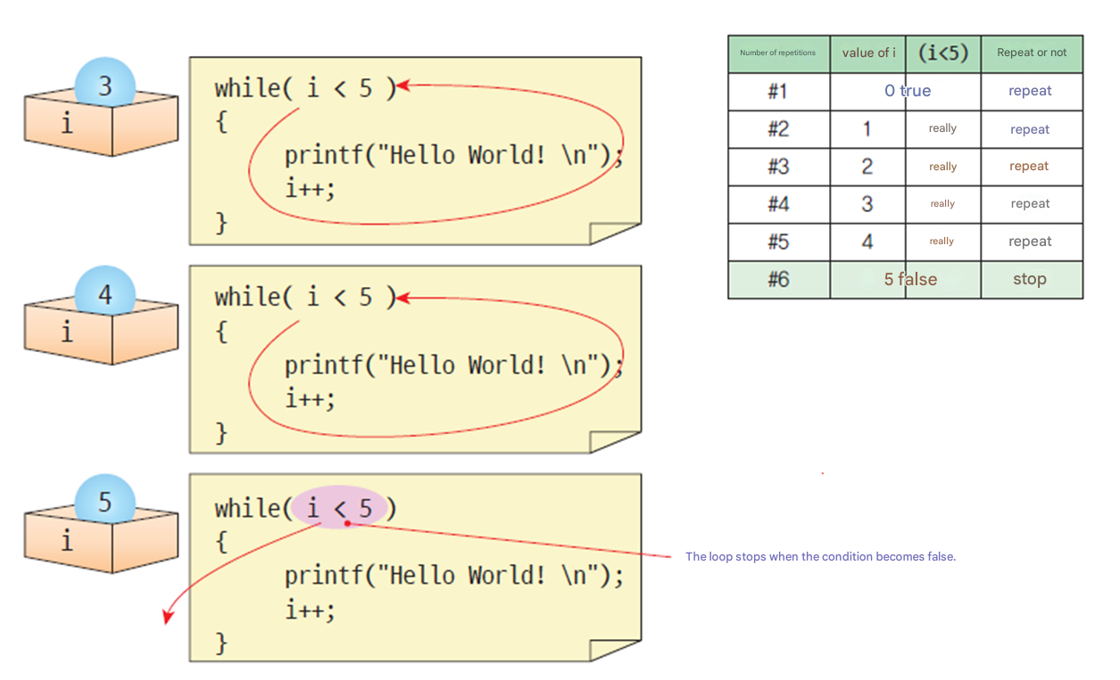
while statement execution process
Number of repeat
Value of i
True
True
True
True
True
False
The loop stops when
the condition becomes false.

Slide 13
Example #1
// Program to print multiplication tables using while loop
#include < stdio.h >
int main( void )
{
int n;
int i = 1;
printf ( " The string you want to print : " );
scanf ( "%d" , &n);
while ( i <= 9)
{
printf ( "%d*%d = %d \n" , n, i , n* i );
i ++;
}
return 0;
}
Enter the number you want to print : 9
9*1 = 9
9*2 = 18
9*3 = 27
....
9*9 = 81

Slide 14
Example #2
// Program to output square values using a while loop
#include <stdio.h>
int main( void )
{
int n;
printf( "===================================\n");
printf( " n n squared \n");
printf( "===================================\n");
n = 1;
while (n <= 10)
{
printf( "%5d %5d\n" , n, n*n);
n++;
}
return 0;
}
==============
n square of n
==============1 1
2 4
3 9
4 16
5 25
6 36
7 49
8 64
9 81
10 100

Slide 15
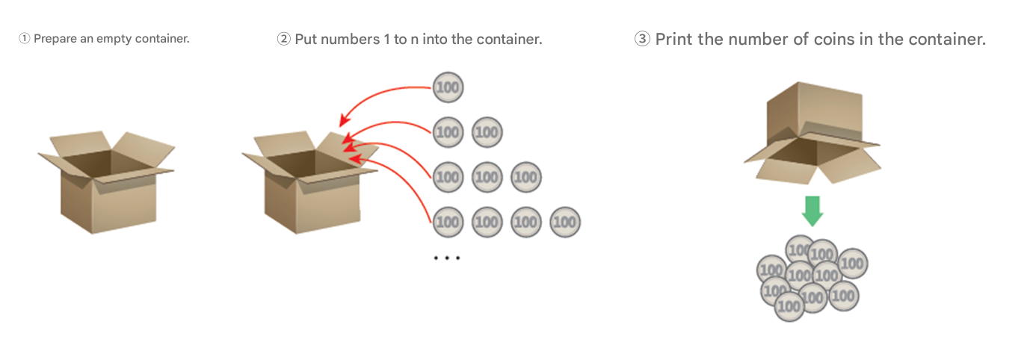
Example #3
Practice
Program to calculate the sum from 1 to n
Enter an integer : 3
The sum of 1 to 3 is

Slide 16
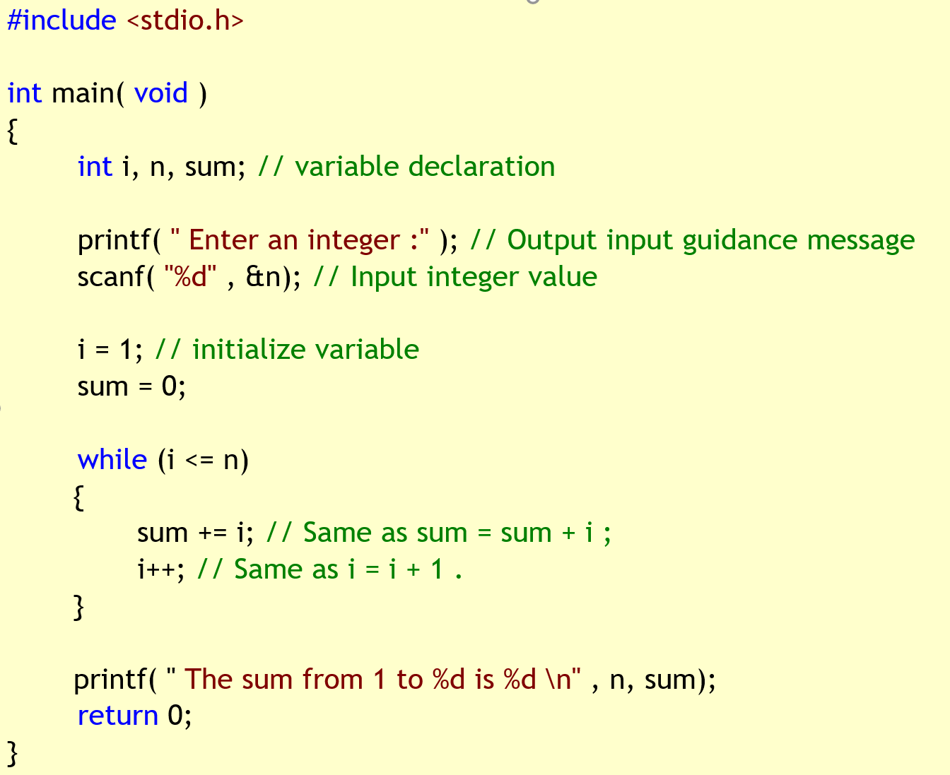
Example #3
Enter an integer : 3
The sum of 1 to 3 is

Slide 17
Example #5
the five values entered by the user and print the result.
(Repeat input)
Enter a value : 10
Enter a value : 20
Enter a value : 30
Enter a value : 40
Enter a value : 50
The total is 150 .

Slide 18
Example #5
// Sum program using while loop
#include <stdio.h>
int main( void )
{
int i, n, sum;
i = 0; // initialize variables
sum = 0; // Initialize variables
while (i < 5)
{
printf( " Enter a value : " );
scanf( "%d" , &n);
sum = sum + n; // Same as sum += n ;
i++;
}
printf( " The total is %d .\n" , sum);
return 0;
}
Enter a value : 10
Enter a value : 20
Enter a value : 30
Enter a value : 40
Enter a value : 50
The total is 150 .

Slide 19
if and while statements
if ( condition )
{
...
...
}
It is executed only once when the condition is met.
while ( condition )
{
...
...
}
If the condition is met, it is executed repeatedly multiple times.

Slide 20
Causion: while loops
int i = 1;
while (i < 10)
{
printf ( " Looping \n" ):
i--;
}
The variable decreases,
not increases
int i = 0;
while ( i < 3)
printf ( " Looping \n" ):
i++;
Not included in a repeating loop
Because no {}.

Slide 21
True and False
#include < stdio.h >
int main( void )
{
int i = 3;
while (i)
{
printf ( "%d is true ." , i);
i--;
}
printf ( "%d is false ." , i);
}
3 is true .
2 is true .
1 is true .
0 is false .
3 is true .
2 is true .
1 is true .
0 is false .

Slide 22
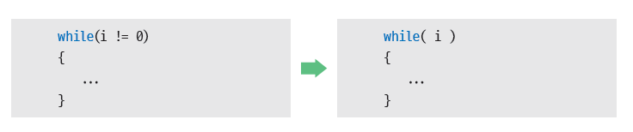
Conventional form

Slide 23
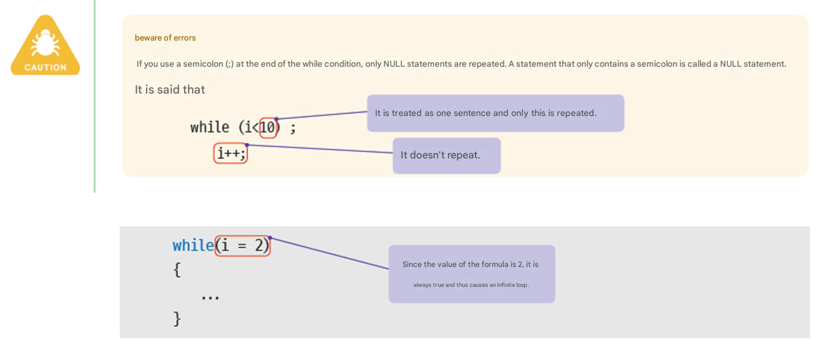
caution
If you use a semicolon(;) at the end of the while condition, only NULL statements are repeated.
A statement that only contains a semicolon is called a NULL statement
Since the value of the expression is 2,
it is always true and thus causes an infinite loop.

Slide 24
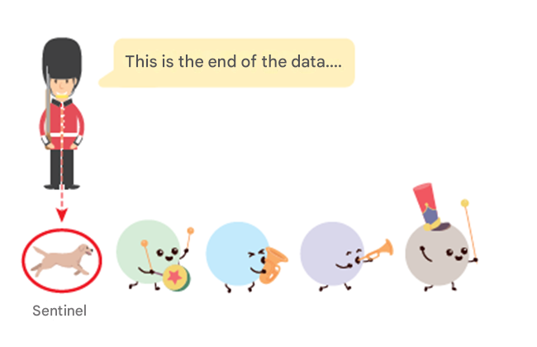
Sentinel ( Using sentinel value )
Sentinel : A special value that signals the end of input data.

Slide 25
Problem of calculating the average of grades (How to design & implement)
Let's write a program that receives an arbitrary number of grades from the user, calculates their average, and then prints them .
-1 is used as a sentinel value .
Enter
Enter your grade : 10
Enter your grade : 20
Enter your grade : 30
Enter your grade : 40
Enter your grade : 50
Enter your grade : -1
The average score is 30.000000 .

Slide 26
The problem of finding the average of grades
Find the average of the grades .
1. Initialize the required variables .
2. Enter the grades, calculate the total, and count the number of grades.
3. Calculate the average and display it on the screen .
1. Initialize the required variables .
(1) Initialize sum to 0 .
(2) Initialize n to 0 .
(3) Initialize grade to 0 .

Slide 27
The problem of finding the average of grades
2. Enter the grades, calculate the total, and count the number of grades .
while if the score is not less than 0
(1) Read the grade from the user and save it in grade.
(2) Accumulate this score in sum.
(3) n is increased by one.
3. Calculate the average and display it on the screen .
(1) Divide sum by n and store it in average.
(2) Print the average on the screen.

Slide 28
Sentinel Example 1/2
// Program to find the average grade using a while loop
#include < stdio.h >
int main( void )
{
int grade, n;
float sum, average;
// Initialize the necessary variables .
n = 0;
sum = 0;
grade = 0;
printf ( " Enter a negative number to end grade entry \n" );

Slide 29
Sentinel Example 2/2
// Enter the grades , calculate the total, and count the number of students .
while (grade >= 0)
{
printf ( " Enter your grades : " );
scanf ( "%d" , &grade);
sum += grade;
n++;
}
sum = sum - grade; // remove the last data .
n--; // Remove the last data .
// Calculate the average and print it to the screen .
average = sum / n;
printf ( " The average of the grades is %f .\n" , average);
return 0;
}
Enter
Enter your grade : 10
Enter your grade : 20
Enter your grade : 30
Enter your grade : 40
Enter your grade : 50
Enter your grade : -1
The average score is 30.000000 .

Slide 30
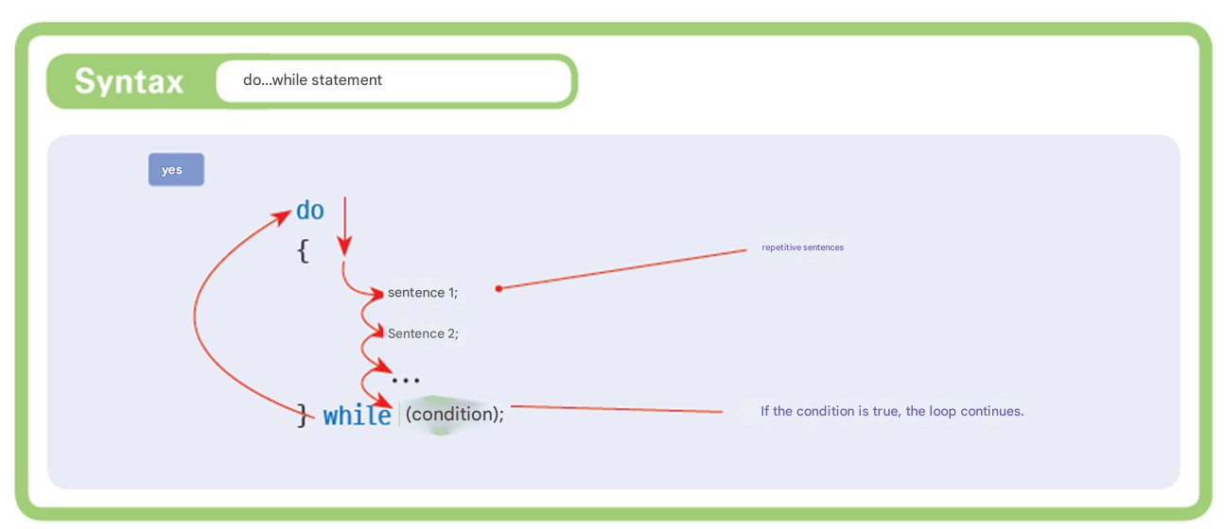
“do...while” statement
Repeated sentence
If the condition is true, the loop continues.

Slide 31
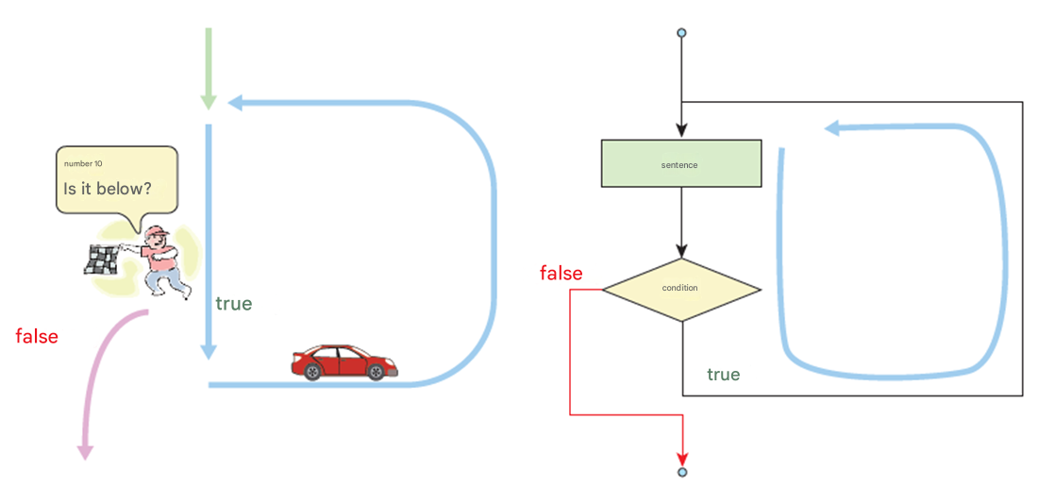
“do-while” statement
Executes the loop statement at least once.
Less than
10 times?
sentence
condition

Slide 32
Example #1
Let's write a program that adds the entered numbers until the user enters 0 using the do...while statement .
Enter an integer : 10
Enter an integer : 20
Enter an integer : 30
Enter an integer : 0
Sum of numbers = 60

Slide 33
Example #1
// Add numbers until the user enters 0 .
#include <stdio.h>
int main( void )
{
int number, sum = 0;
// The loop body is executed at least once .
do
{
printf ( " Enter an integer : " );
scanf ( "%d" , &number);
sum += number;
} while (number != 0);
printf ( " Sum of numbers = %d \n" , sum);
return 0;
}

Slide 34
Example #2
do..while statement is widely used in input processing.
1--- Create new
2--- Open file
3--- Close file
Select one : 1
Selected menu =1

Slide 35
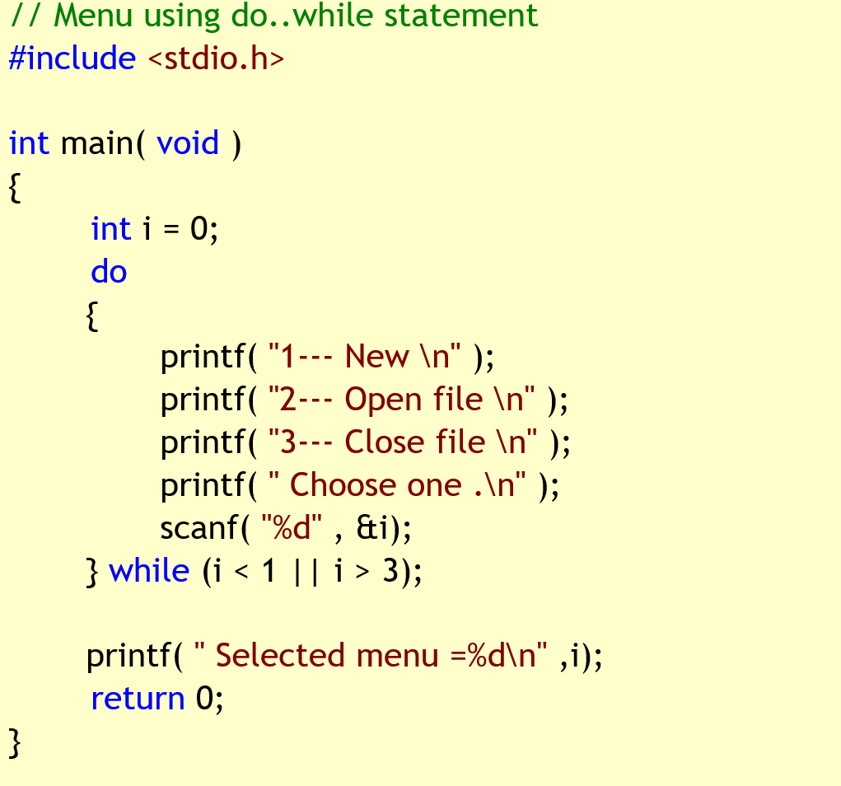
Example #2
Practice

Slide 36
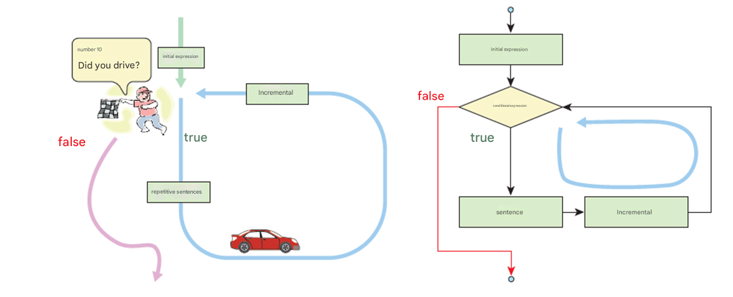
for loop
A structure that repeats a set number of times
Less than
10 times?
Initial
statement
Initial statement
Conditional statement

Slide 37
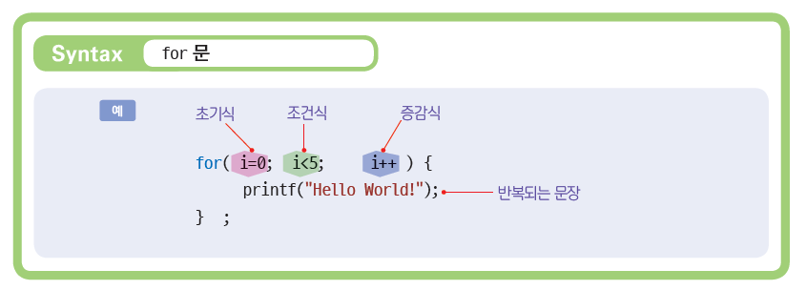
Structure of “for” statement
Init statement
Condition
Increase/decrease
Repeative sentence

Slide 38
Initial expression, conditional expression, incremental expression
Initial
The initialization expression is executed only once before starting the repeating loop. It is mainly used to initialize variable values .
Conditional expression
A formula that checks the condition for repetition. If the value of this expression becomes false, the repetition stops .
Incremental
After one loop execution is complete, the increment expression is executed.
Initial
Conditional expression
for ( i = 0; i < 5; i ++)
printf ( "Hello World!\n" );
Incremental

Slide 39
Example
Print
#include < stdio.h >
int main( void )
{
int i ;
for ( i = 0; i < 5; i ++) // i increases
printf ( "Hello World!\n" );
return 0;
}
Hello World!
Hello World!
Hello World!
Hello World!
Hello World!

Slide 40
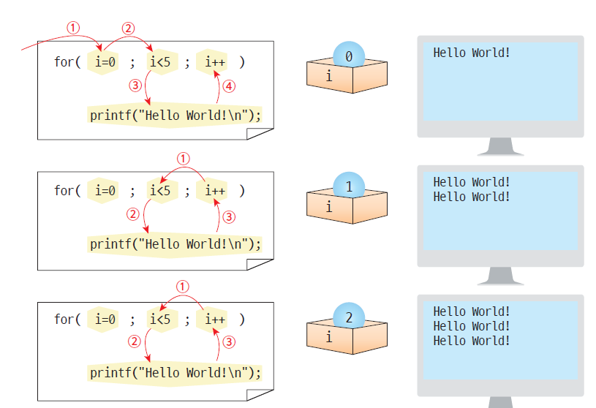
The execution process of “for”

Slide 41
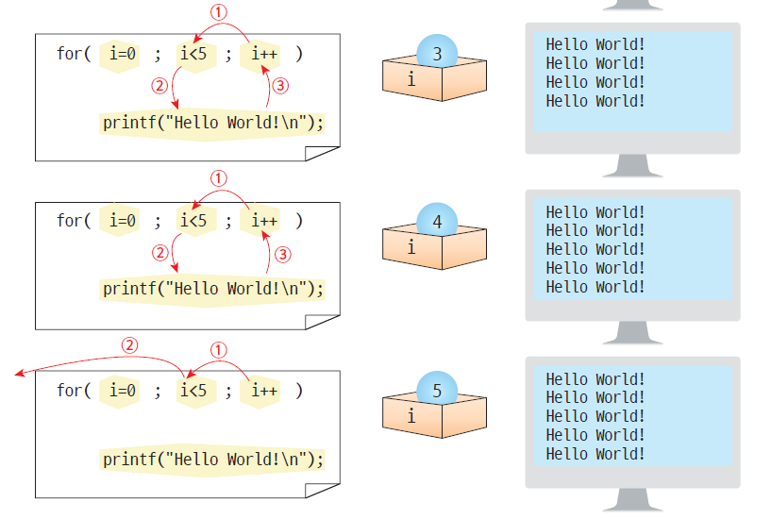
The execution process of “for”

Slide 42
Example #2
Practice
Let's write a program that adds integers from 1 to 10 and finds the sum .
Sum of integers from 1 to 10 = 55

Slide 43
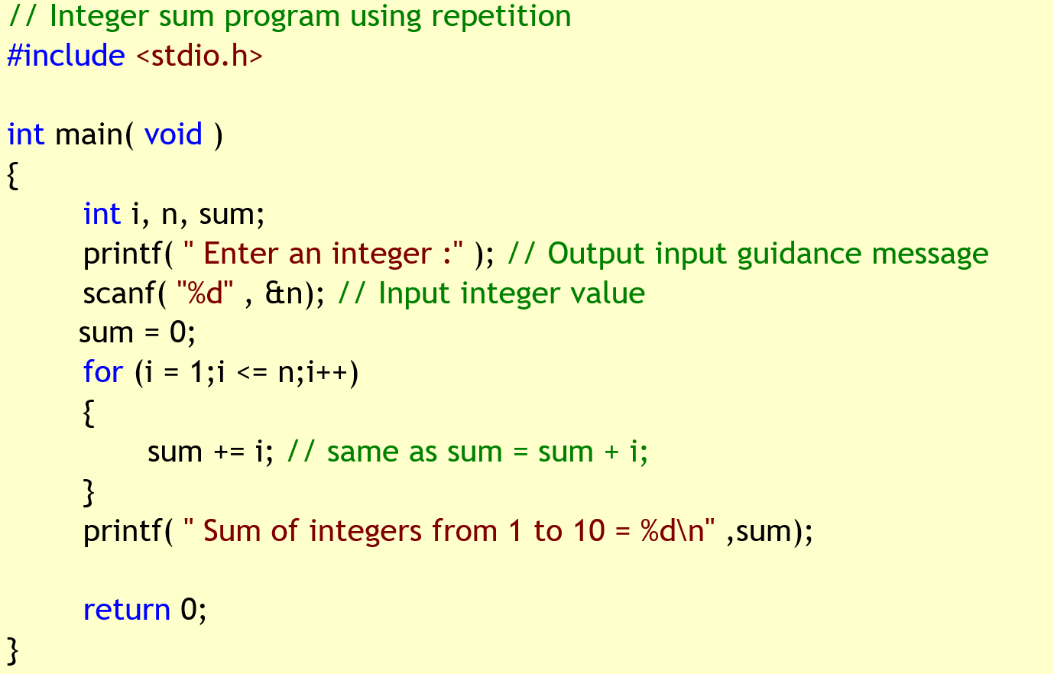
Example #2
Sum of integers from 1 to 10 = 55

Slide 44
Example #3
Let's draw a box like the following on the screen using the * character .
**********
* *
* *
* *
* *
* *
**********

Slide 45
Example #3
// Drawing a square using repetition
#include < stdio.h >
int main( void )
{
int i;
printf ( "**********" );
for (i = 0;i < 5; i++)
printf ( "* *" );
printf ( "**********" );
return 0;
}
**********
* *
* *
* *
* *
* *
**********

Slide 46
Relationship between while loop and for loop
for (
Initial
Initial
;
while
(
Conditional expression
)
Conditional expression
;
{
Incremental
)
{
Sentence 1
;
Sentence 1
;
Sentence 2
;
Sentence 2
;
...
...
Incremental
;
}
}

Slide 47
Variables can be declared inside “for” loops
for ( int i =0; i < 10; i ++) {
…
}

Slide 48
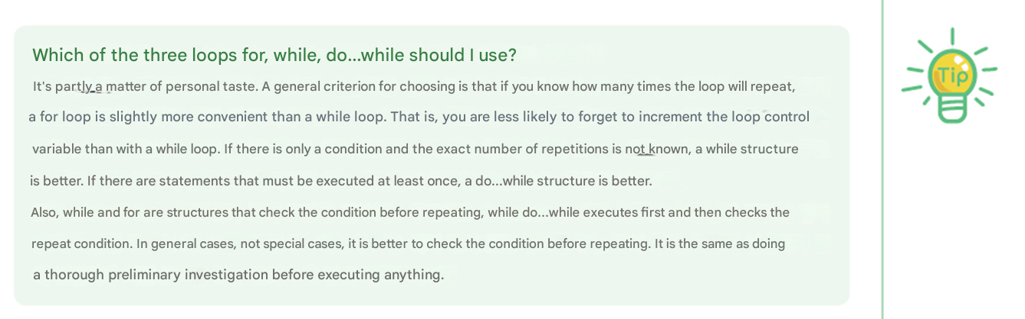
Tip
Which of the three loops for, while, do...while should I use?
It's partly a matter of personal taste. A general criterion for choosing is that if you know how many times the loop will repeat, a for loop is slightly more convenient than a while loop. That is, you are less likely to forget to increment the loop control variable than with a while loop. If there is only a condition and the exact number of repetitions is not known, a while structure is better. If there are statements that must be executed at least once, a do...while structure is better.
Also, while and for are structures that check the condition before repeating, while do...while executes first and then checks the repeat condition. In general cases, not special cases, it is better to check the condition before repeating. It is the same as doing a thorough preliminary investigation before executing anything.

Slide 49
Various forms of increasing and decreasing formulas
for ( int i = 10; i > 0; i -- )
printf ( "Hello World!\n" );
Using subtraction
for ( int i = 0; i < 10; i += 2 )
printf ( "Hello World!\n" );
Increase by 2
for ( int i = 1; i < 10; i *= 2 )
printf ( "Hello World!\n" );
Multiply by 2
for ( int i = 0; i < 100; i = ( i * i ) + 2 )
printf ( "Hello World!\n" );
Any formula is possible

Slide 50
Various forms of increasing and decreasing formulas
for ( ; ; )
printf ( "Hello World!\n" );
Infinite loop
for ( ; i<100; i++ )
printf( "Hello World!\n" );
One part may be missing
for (i = 0, k = 0; i < 100; i++ )
printf( "Hello World!\n" );
two or more variables
for ( printf (" loop start " ), i = 0; i < 100; i ++ )
printf ( "Hello World!\n" );
Any formula is possible
for (i = 0; i < 100 && sum < 2000; i++ )
printf ( "Hello World!\n" );
Any complex expression can be a conditional expression.

Slide 51
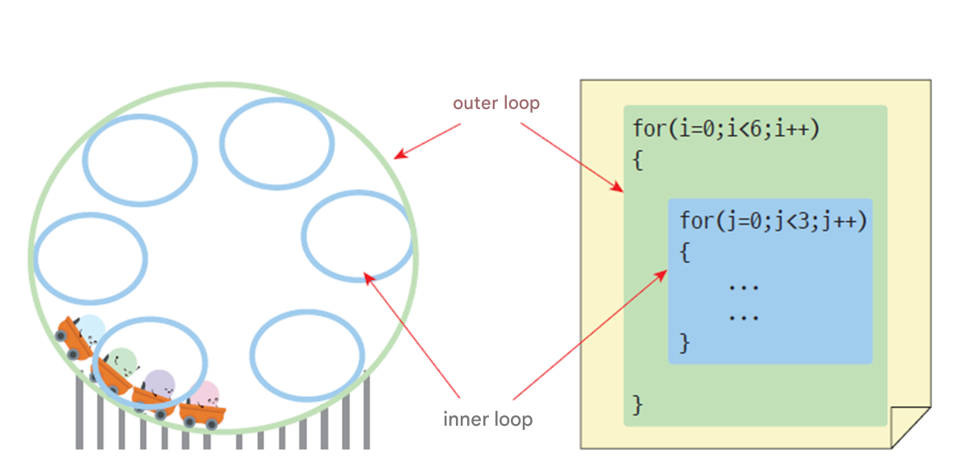
Nested loop
loop : A loop that is located within another loop.

Slide 52
Example #1
The following example prints the * symbol in a square shape
**********
**********
**********
**********
**********

Slide 53
Example #1
// Program to print * symbols in a square shape using
#include < stdio.h >
int main( void )
{
int x, y;
for (y = 0;y < 5; y++)
{
for (x = 0;x < 10; x++)
printf ( "*" );
printf ( "\n" );
}
return 0;
}
**********
**********
**********
**********
**********

Slide 54
Example #2
Practice
Let's change the previous example a little so that it prints as follows . If you analyze the execution result in detail, you can see that y * are printed on the yth line.
*
**
***
****
*****

Slide 55
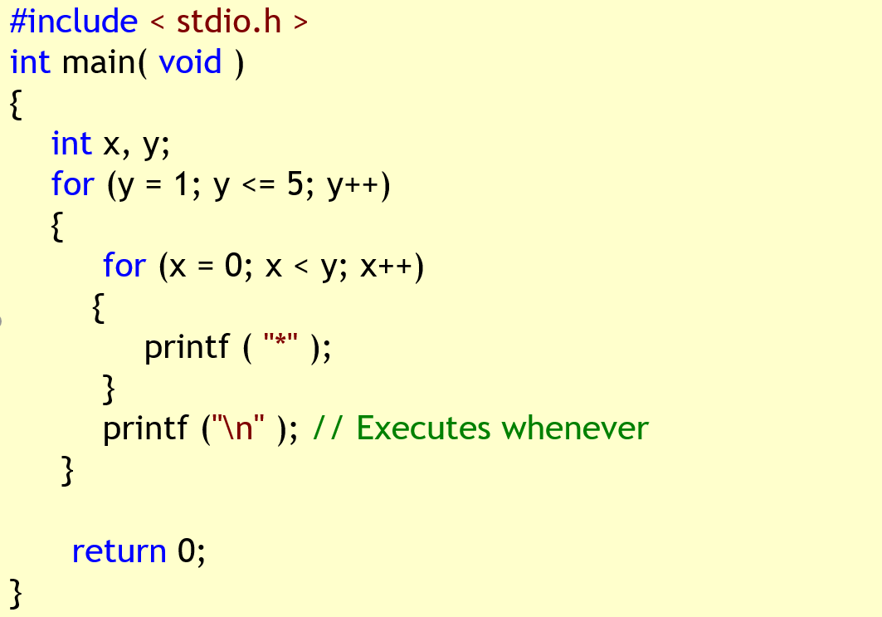
Example #2
*
**
***
****
*****

Slide 56
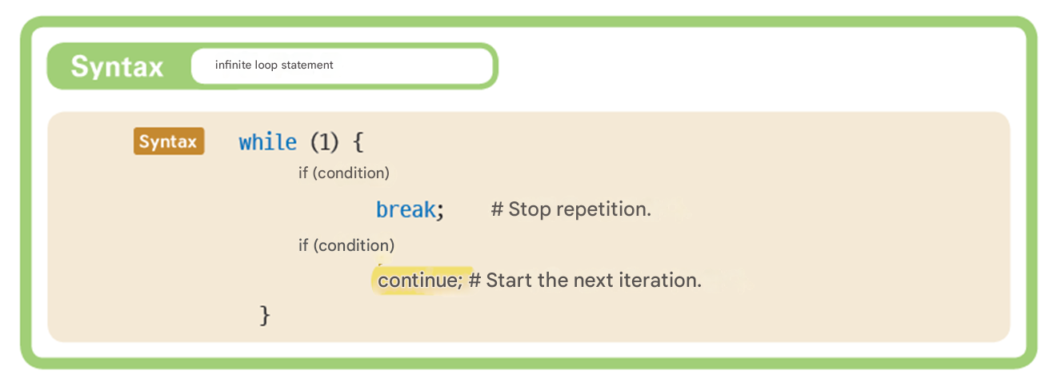
Infinite loop
In a conditional control loop, sometimes the program repeats itself infinitely . This is known as an infinite loop . This is a problem because when an infinite loop occurs, the program cannot escape from it .
But sometimes, intentionally Infinite loops are used because, for example, a traffic light control program must repeat infinitely.

Slide 57
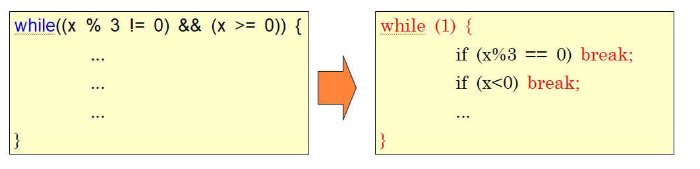
When infinite loops are useful
It is especially used in cases where the conditions for exiting the loop are tricky. For example, let's say you need to exit the while loop if the number entered by the user is a multiple of 3 or a negative number.

Slide 58
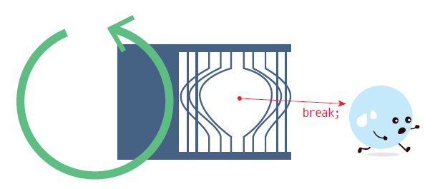
“break” statement
break statement is used to exit a repeating loop .

Slide 59

The only case you need “goto” statement
If a problem occurs inside a nested loop , you can use goto to quickly exit the whole loop.
break​ If you use it , you can only break one loop.
for( i =0;i<10;i++){
for(j=1;j<=10;j++){
// some work
break;
// some work
}
}

Slide 60
goto statement
#include < stdio.h >
int main( void )
{
int x, y;
for (y = 1; y < 10000; y++)
{
for (x = 1; x < 50; x++)
{
if ( _ kbhit () ) goto OUT;
printf ( "*" );
}
printf ( "\n" );
}
OUT:
return 0;
}
*************************************************
*************************************************
***********

Slide 61
continue statement
Print all integers from 0 to 10, excluding those that are multiples of 3.
#include < stdio.h >
int main( void )
{
int i ;
for ( i=0 ; i<10 ; i++ )
{
if ( i%3 == 0 )
continue;
printf ( "%d " , i );
}
return 0;
}
1 2 4 5 7 8

Slide 62
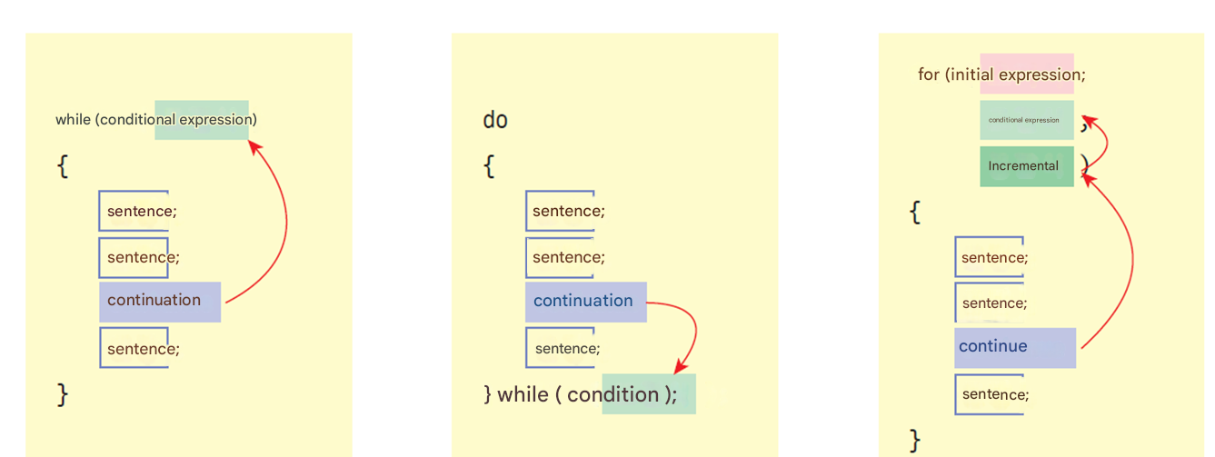

“continue” statement

Slide 63
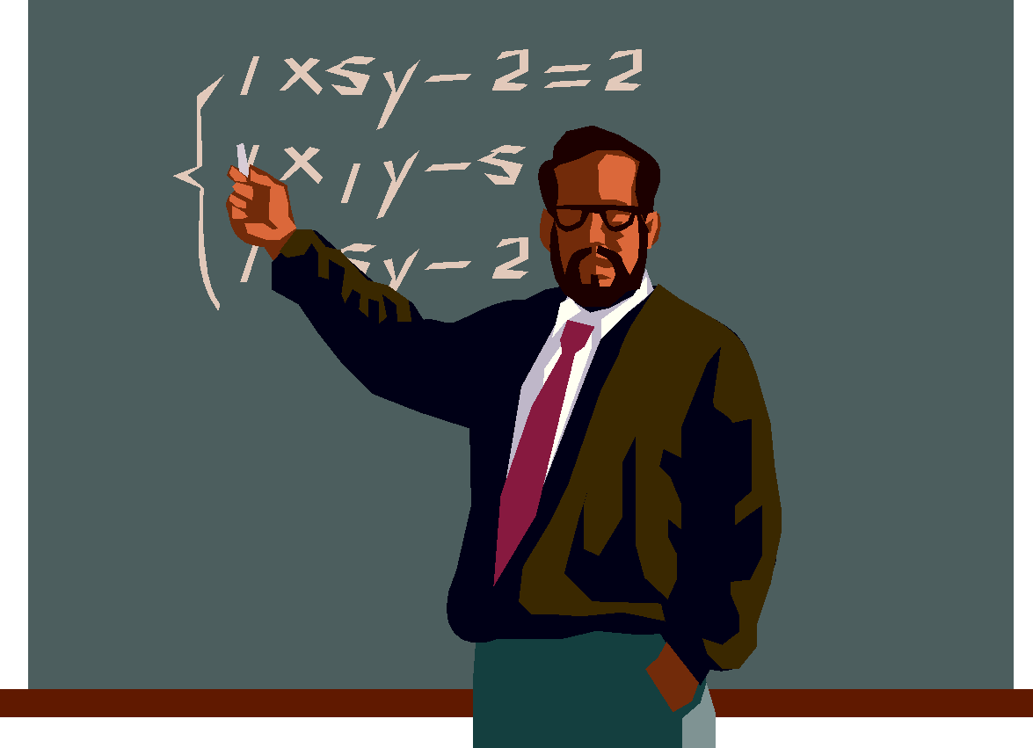

Q & A

